Slide 1
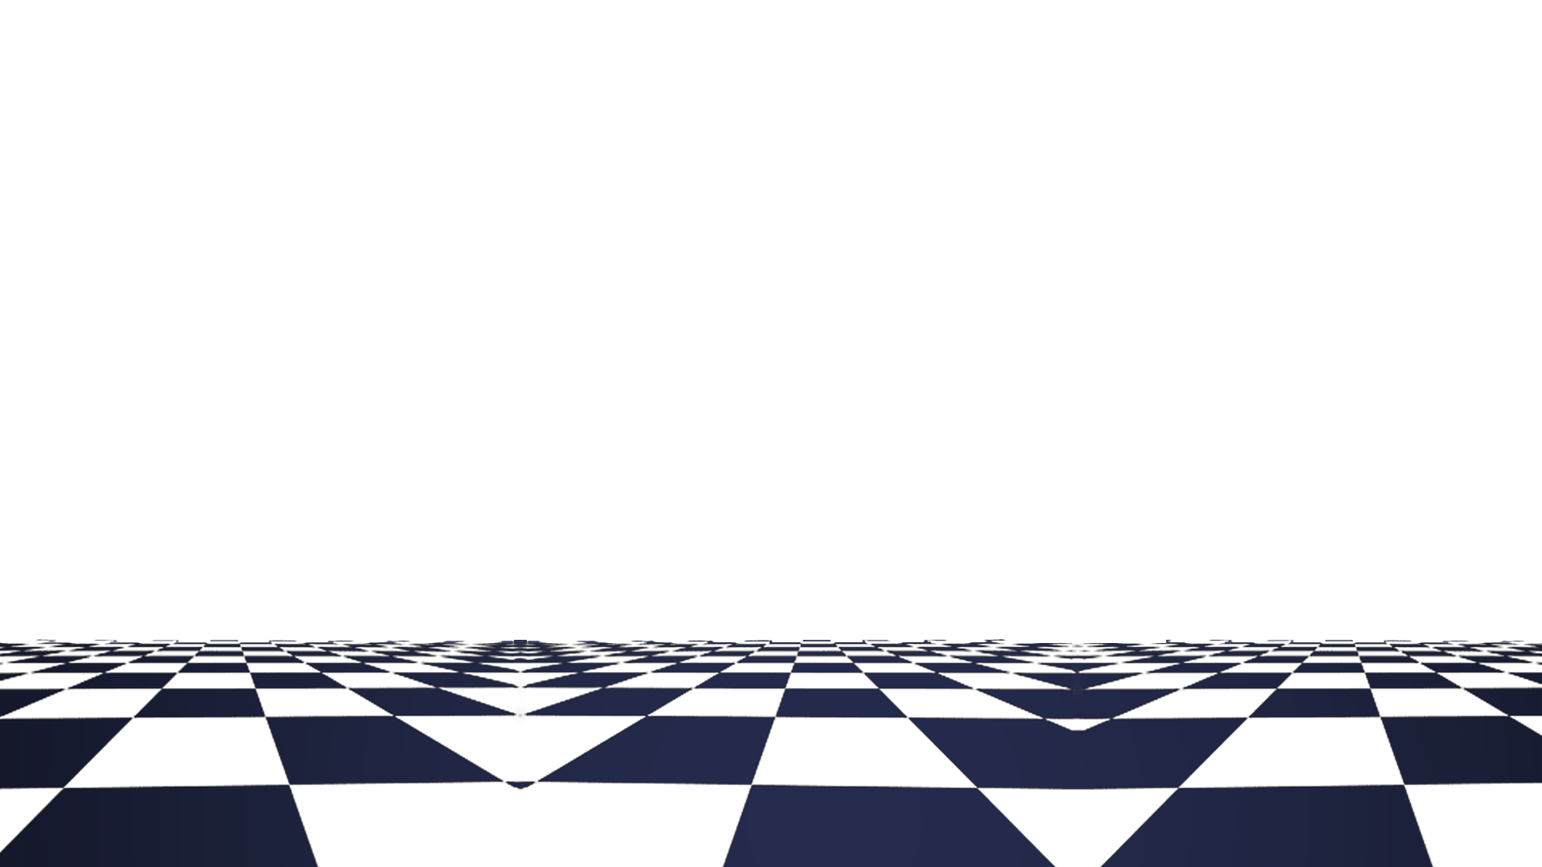
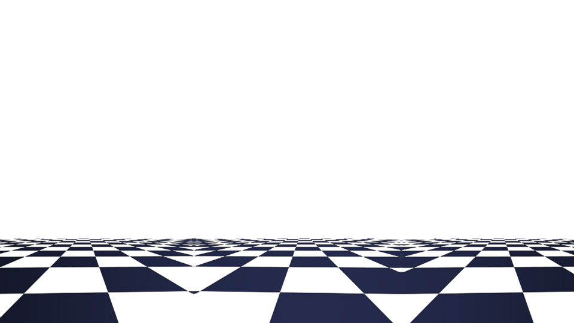
Chess Game Project
Intro to software engineering
SWE1
Group: Padozeli

Slide 2
Team Members
Thanas Papa
Roni Domi
Klejdi Gjyzeli

Slide 3
Tasks
Thanas Papa
Game logic and tracking
Board Generation
Piece Logic, and movement
Roni Domi
Menu design
GUI and sound design & implementation
Game customization
Klejdi Gjyzeli
Documentation
Diagram modelling
Presentation design

Slide 4
Project Requirements
Purpose:
The purpose of a chess game is to provide an intellectually stimulating and competitive activity for players to test their strategic thinking, problem-solving skills, and tactical abilities.
Scope:
The scope of a chess game encompasses various aspects related to the game itself and the playing experience. This includes:
Gameplay: The scope of a chess game involves the rules, mechanics, and dynamics of the game. It encompasses the movement and abilities of each chess piece, the objective of capturing the opponent's king, and the strategies and tactics employed by players to outmaneuver their opponents.
Player Interaction: The game can be played between two players, in person. The scope of the game includes the interaction between players, such as making moves, capturing pieces.
Decision-Making: Chess requires players to make critical decisions at every turn. The scope of the game involves the evaluation of different moves, considering potential consequences, and selecting the best possible course of action to gain an advantage over the opponent.
Competitive Element: Chess is inherently competitive, and the scope of the game includes the aspect of competition between players. It involves the quest for victory, the pursuit of outsmarting the opponent, and the satisfaction of winning the game.

Slide 5
Project Requirements
In-Scope:
Game rules and mechanics.
Valid moves and piece interactions.
Player decision-making and strategy.
Capturing the opponent's pieces.
Checkmate and victory conditions.
Out-Of-Scope:
Variants and modifications beyond standard chess rules.
Non-traditional game boards or pieces.
Non-essential visual and graphical enhancements.
Platform-specific features not directly related to gameplay.
Historical or cultural context surrounding chess (unless explicitly incorporated into the game).

Slide 6
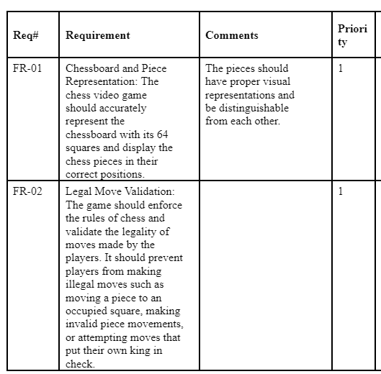
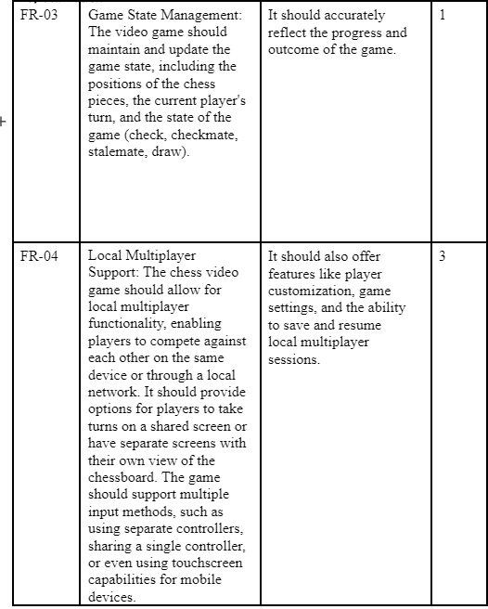
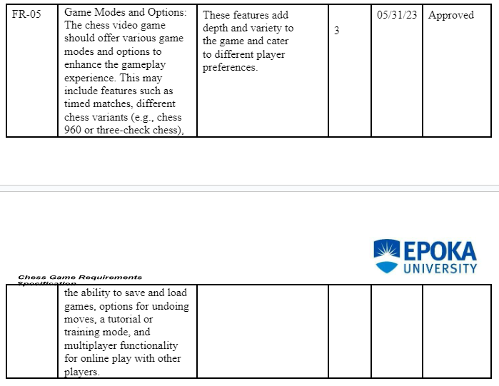
Project Requirements

Slide 7
-Game Logic
In order for the game to work there need to be a number of features that all work together harmoniously and bug free. At first it might seem like to make the game would be an easy task since all that first comes to mind is moving pieces around and taking other pieces but soon you realize that the logic of the game is a lot more complex than that.
Examples: A piece that is absolutley pinned cannot move in a manner than would put the king in check, if the king is in check then the other pieces can only move in a way that would block check like taking the checking piece or moving in the way of the checking piece , blocking check.

Slide 8
Basics of the game
The most basics of the game are the movements of the pieces. A pawn can only move one square forward, a rook can only move horizontally and vertically, a bishop can only move diagonally , a queen can move as the rook and bishop , the knight can only move in an L shape way , and finally the king can move one square in any direction.

Slide 9
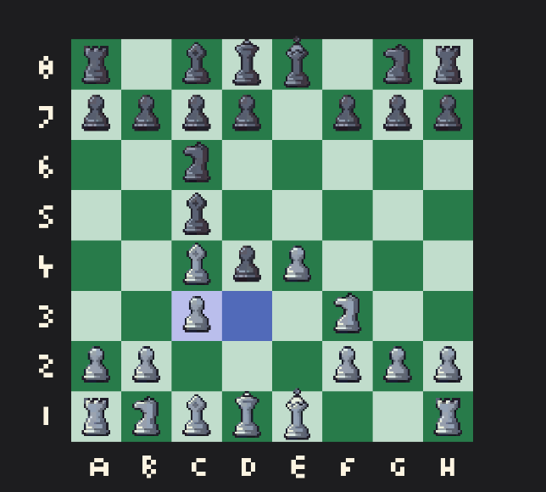
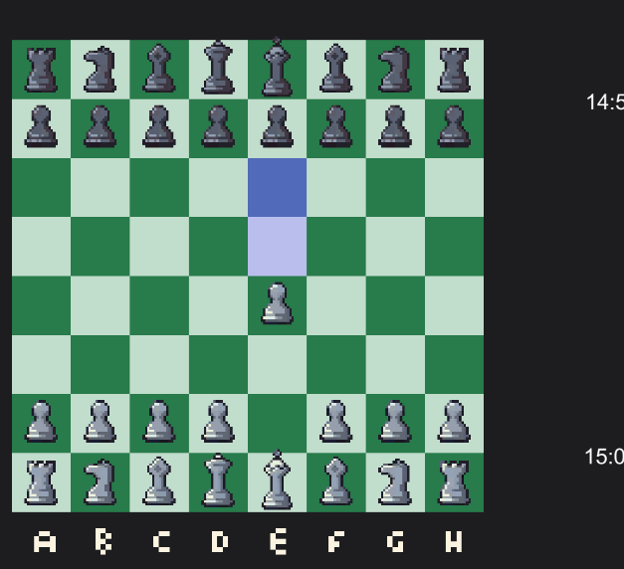
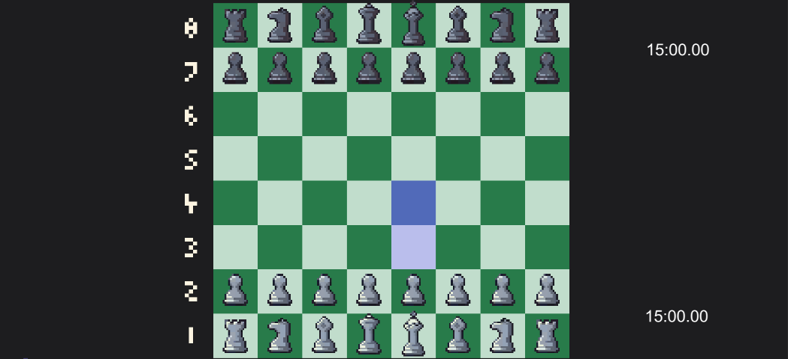
The moves- Pawns:
A pawn can only move forward and only one square at a time , but if it hasn't made a move yet then it can move two squares forward.
Also the pawn cannot take going forward but only one square diagonally.

Slide 10
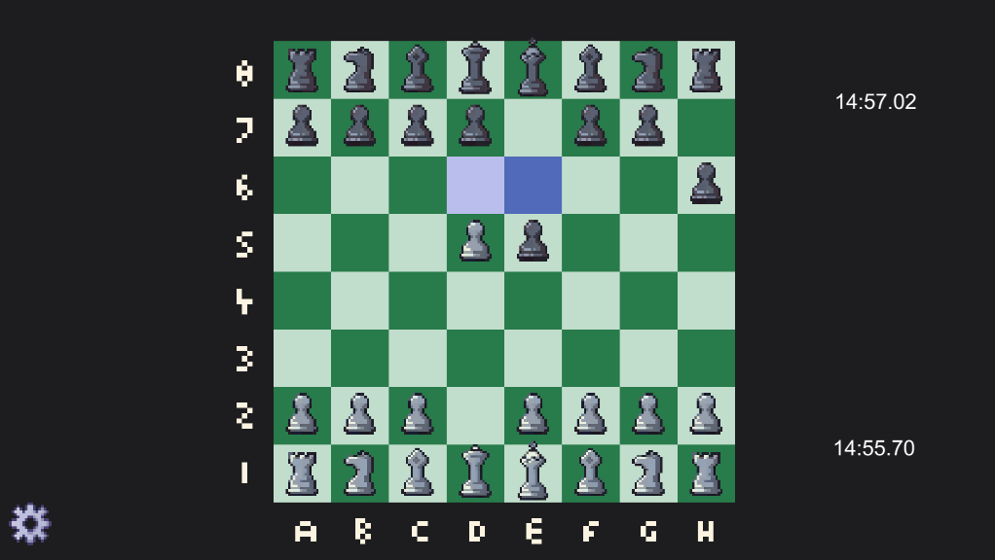
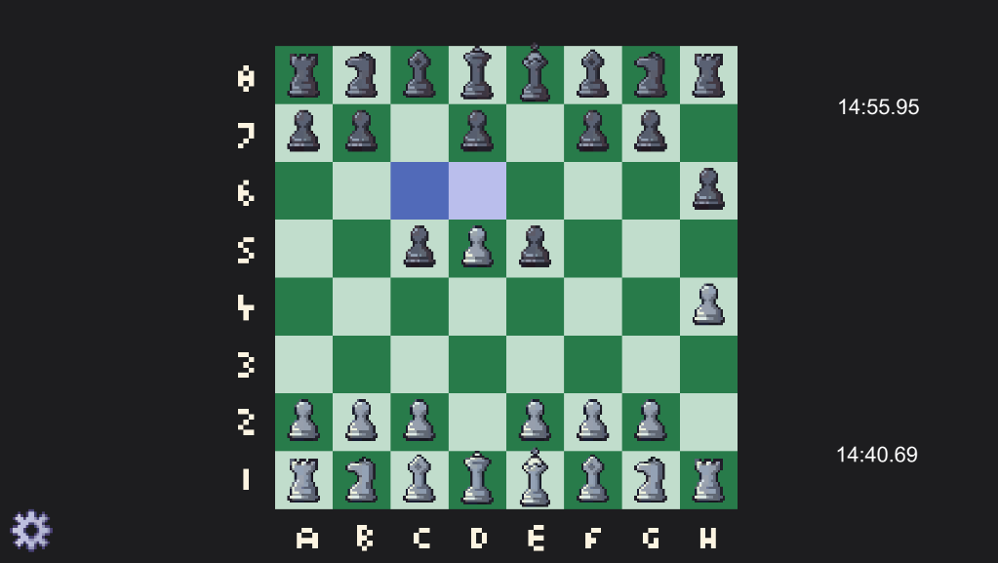
The moves- Panws:
Pawns also have access to a special move called En Passant.
En passant is a special chess move that can occur under specific circumstances. It can only happen immediately after an opponent moves a pawn two squares forward from its starting position, and the moved pawn lands adjacent to your pawn's fifth rank. In this situation, you have the opportunity to capture the opponent's pawn "en passant" as if it had only moved one square forward. The capture must be made on the next move; otherwise, the opportunity is lost. En passant is a unique rule in chess designed to prevent pawns from bypassing capture by moving two squares forward.

Slide 11
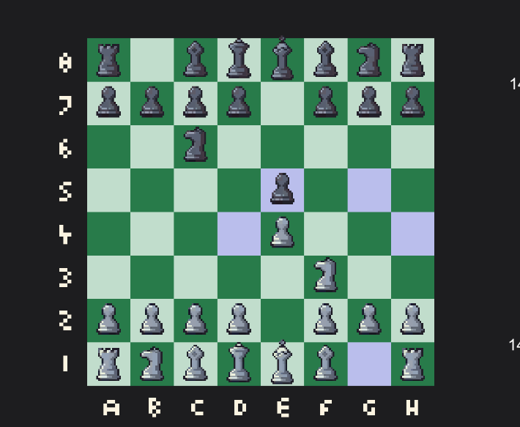
The moves - Knights:
The knight can only move in an L shape manner and is the only piece that can move "above" another piece, but as every other piece it cannot land above a piece of the same color.

Slide 12
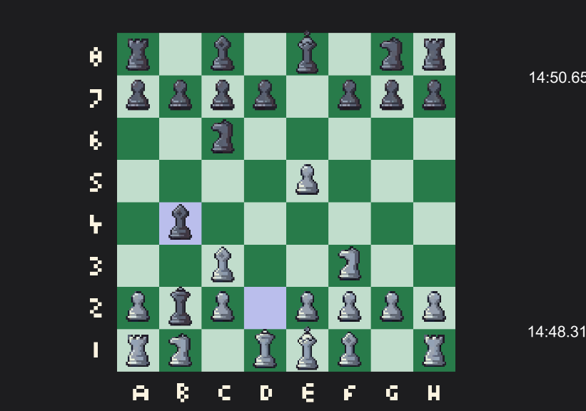
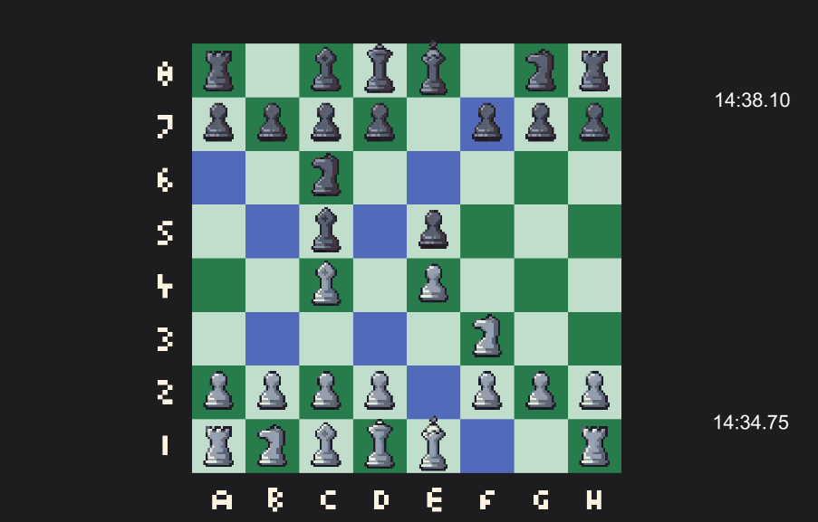
The moves- Bishops:
As mentioned before the bishop can only move diagonally. There isn't much to the bishop except that it's one of the pieces that can pin other pieces.

Slide 13
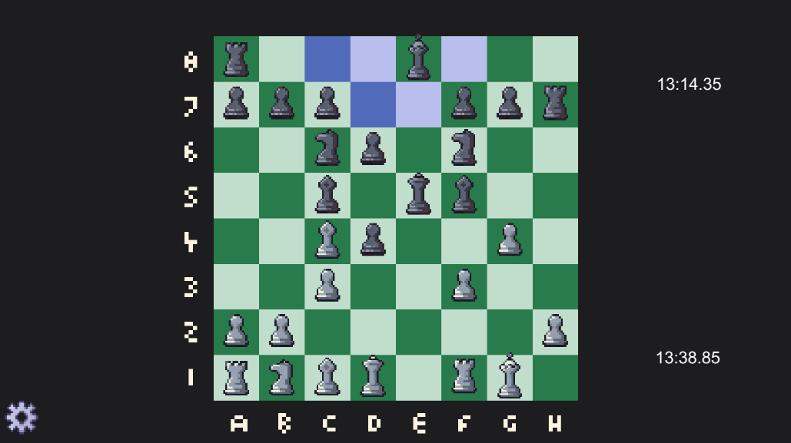
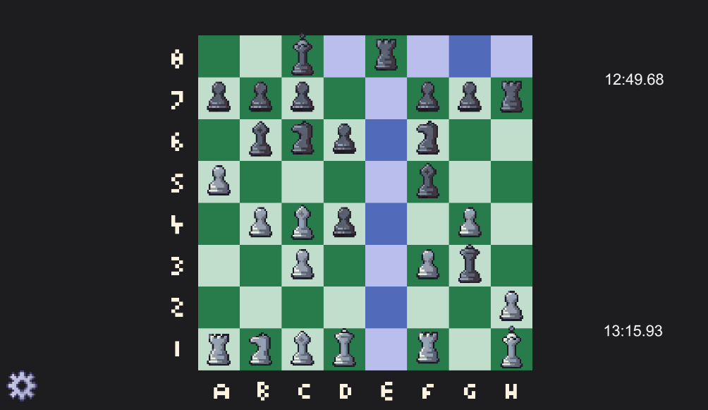
The moves- Rooks:
The rooks are a bit more special in terms of movement, because the movement of the rook is a factor in a move that the king can make: Castling.
The rook can move in any square horizontally and veritcally as long as they way is not interrupted by another piece.

Slide 14
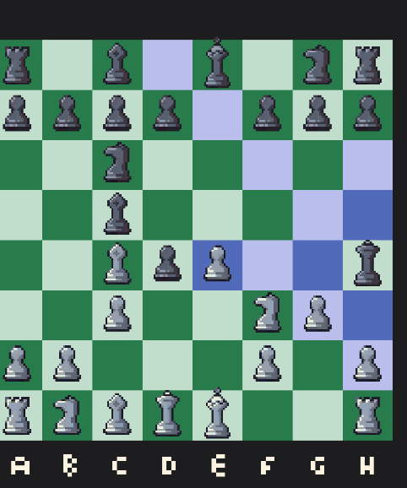
The moves- Queen:
The queen can move as the rook and as the bishop, all these pieces can pin other pieces. Not complicated and It’s the most valuable piece(not counting the king).

Slide 15

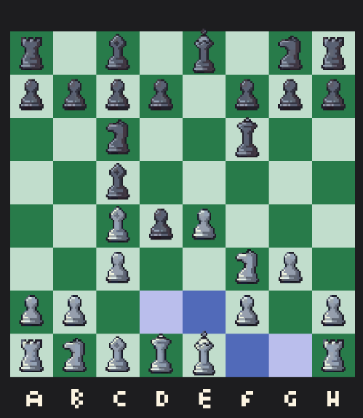
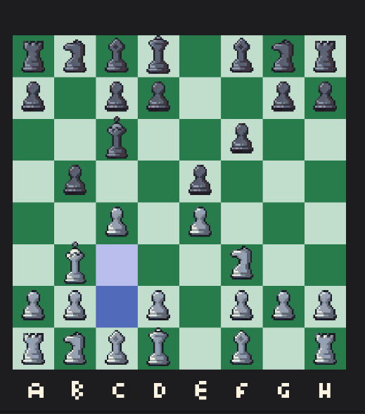
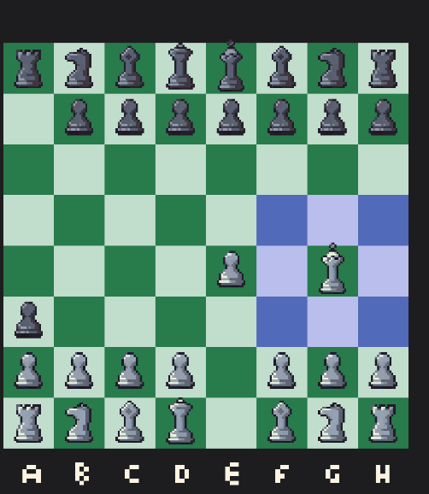
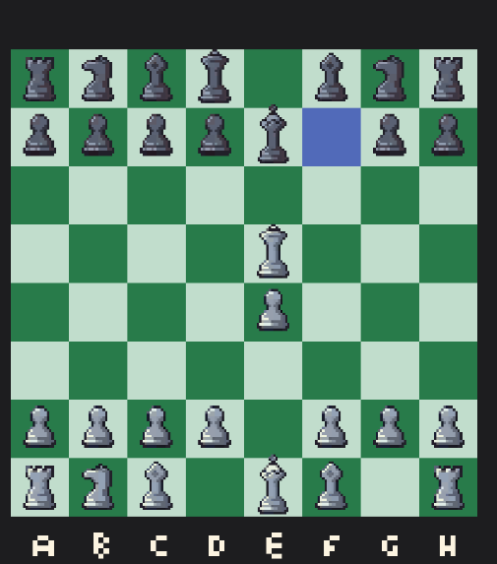
The Moves- The King:
The king can move as the queen but only one square at a time. The king cannot move in a square where it would be in check . The king can also do a special move with the rook called "Castling" where the king moves either two squares to the left and then the left rook moves to the right of the king, or two squares to the right and then the right rook moves to the left of the king.

Slide 16
Taking Pieces
Taking Pieces is generally the same as moving a piece. As in if an opposing piece is in the way of a piece moving, then the moving piece can take the obstructing piece, The only exception to this are the pawns, En Passant and Castling.

Slide 17
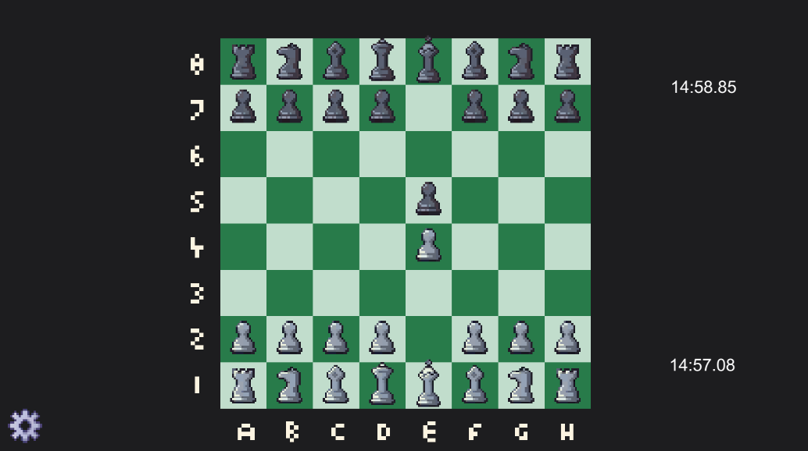
StaleMate and Checkmate
Before we get to stalemate and checkmate , I'll explain a bit about a mechanic in the chess game we've made. Every piece in the game has a variable in it called "Stuck". What this variable does is it determines if a piece can move or not.
For example the two pawns in this position are stuck, because neither of them can move or take other pieces. But those pawns are not the only stuck pieces, the rooks and the C file Bishops are also stuck.

Slide 18
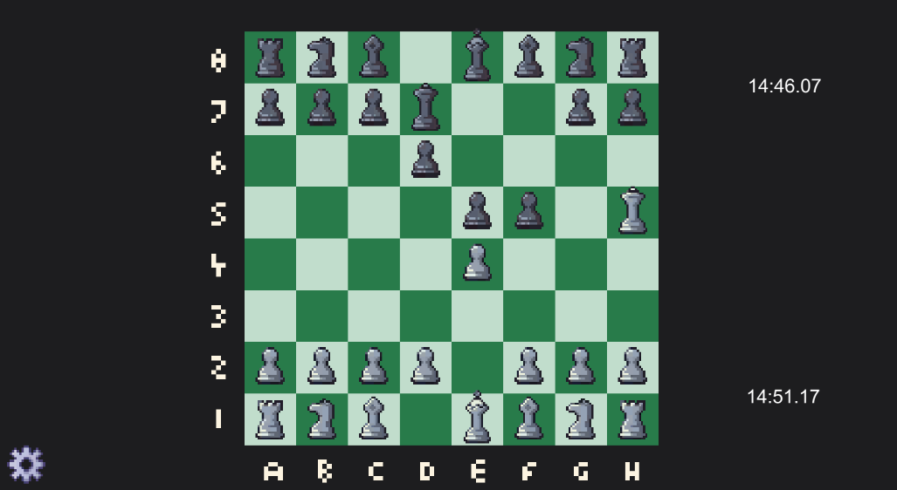
Stalemate and Checkmate
In this position, every black piece that cannot block check is also stuck, since there are no valid moves for any of them.

Slide 19
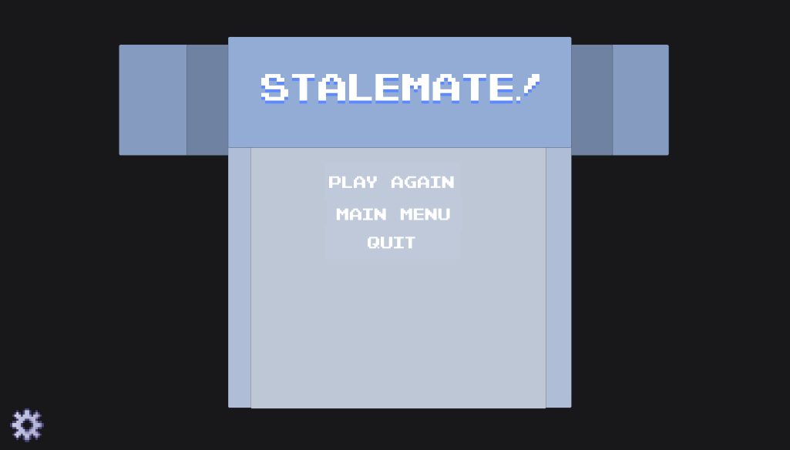
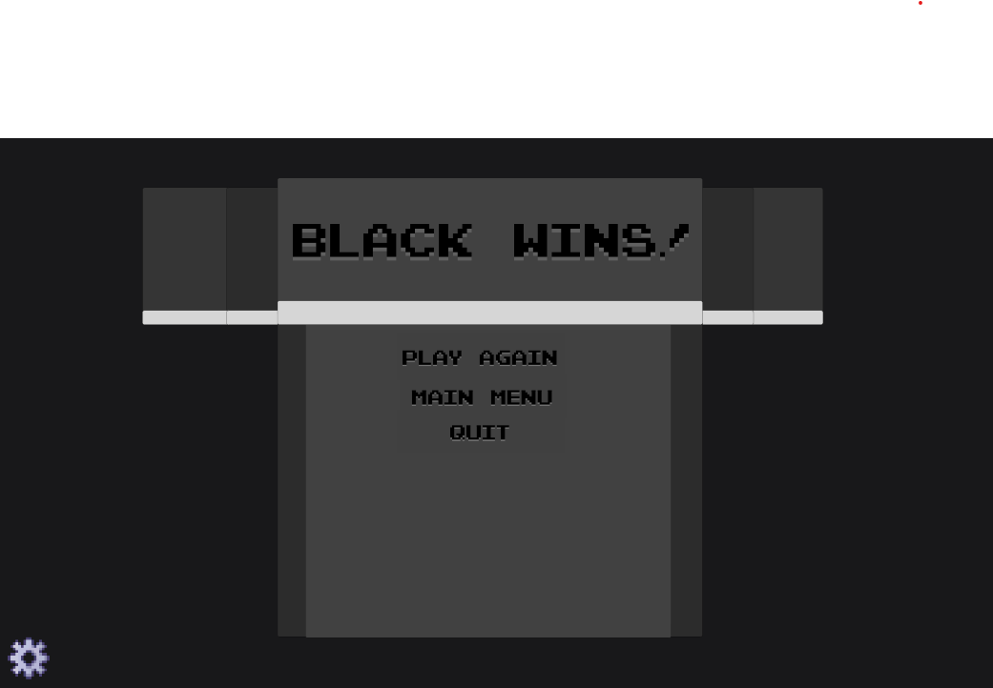
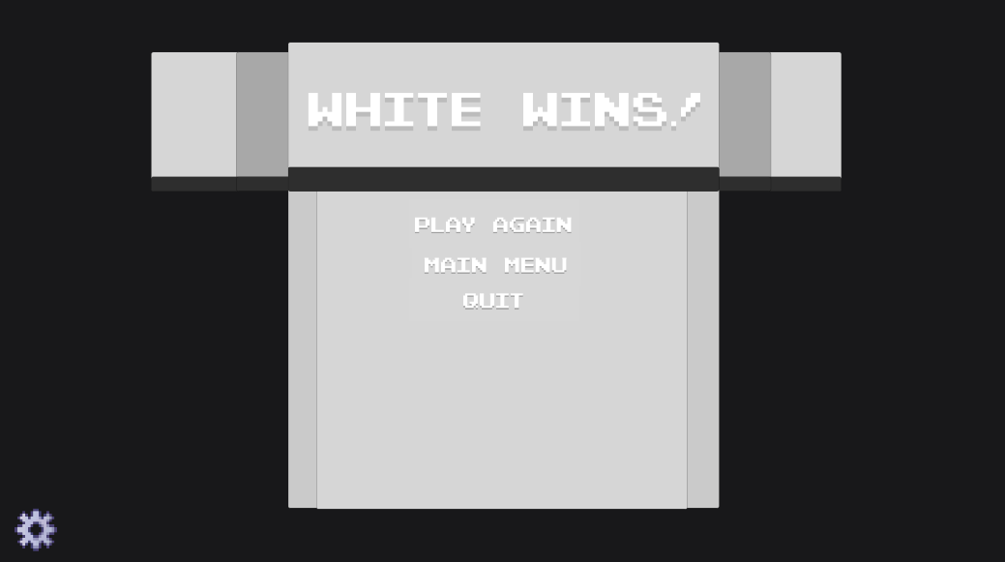
Stalemate and Checkmate
Why is this important?
The way Stalemate and Checkmate work in this game is heavily reliant on this Stuck variable. If its blacks turn and every single piece is either stuck or taken (but blacks king is not in check) then the game ends in a draw since there are no legal moves for black.
Checkmate works almost the exact same, except that if every piece is stuck AND the king is in check , then the game ends due to checkmate and the appropriate winner is decided.

Slide 20
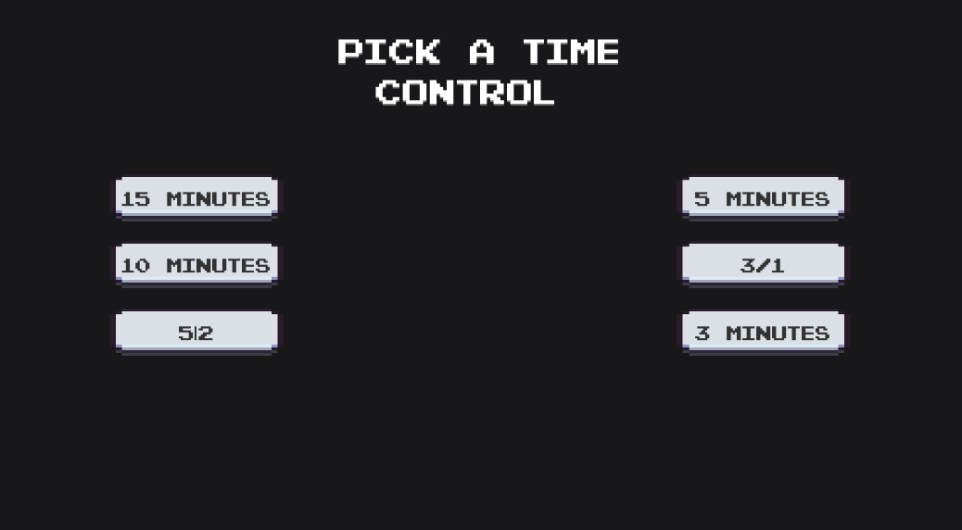
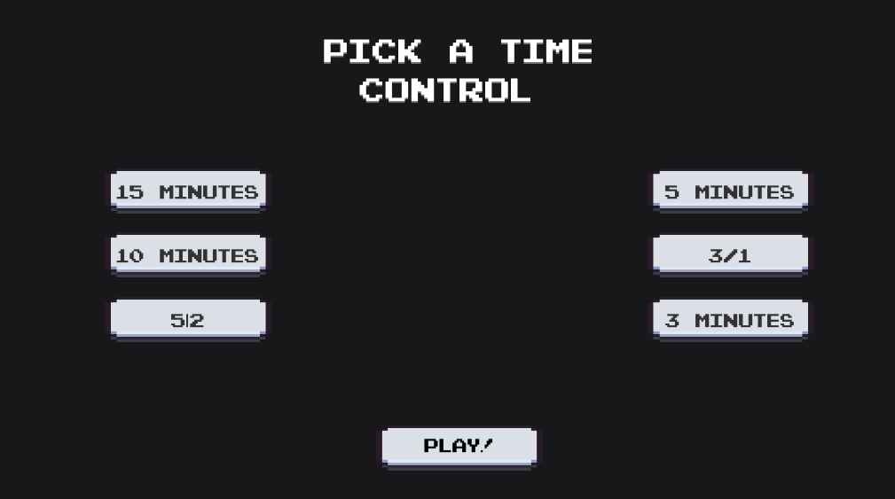
Time control
Time control has been an important aspect of chess games for a long time and as such we decided to implement it into our chess game.
The options for Time control are as follows: 15 minutes for each player, 10 minutes for each player, 5 minutes total for each player, 5 minutes for each player where after every move a player makes 2 seconds is added to their time (increment by 2),3 minutes for each player and finally, 3 minutes for each player with 1 second increment per move.

Slide 21
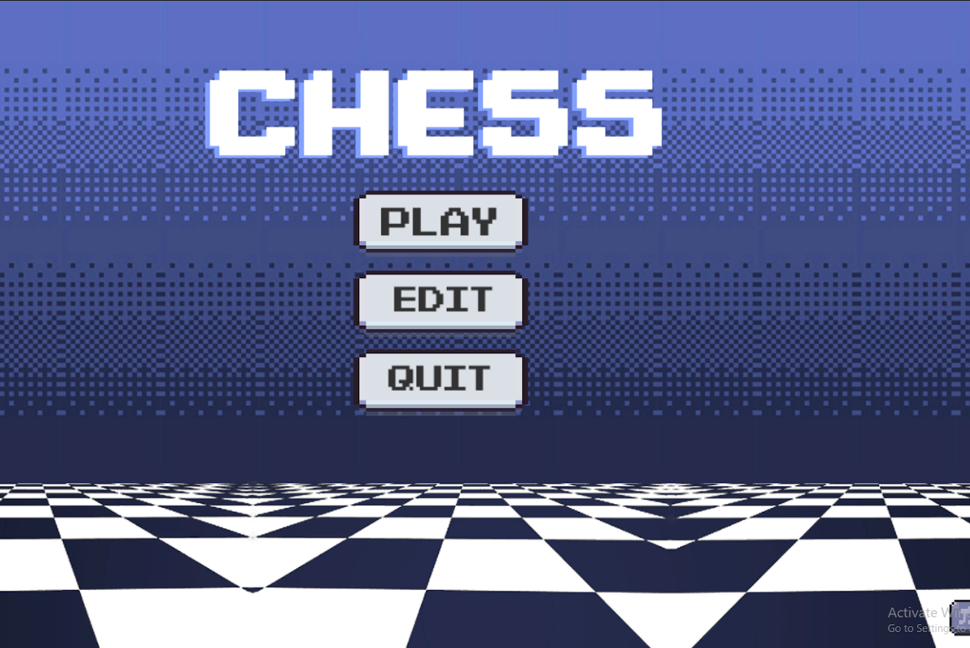
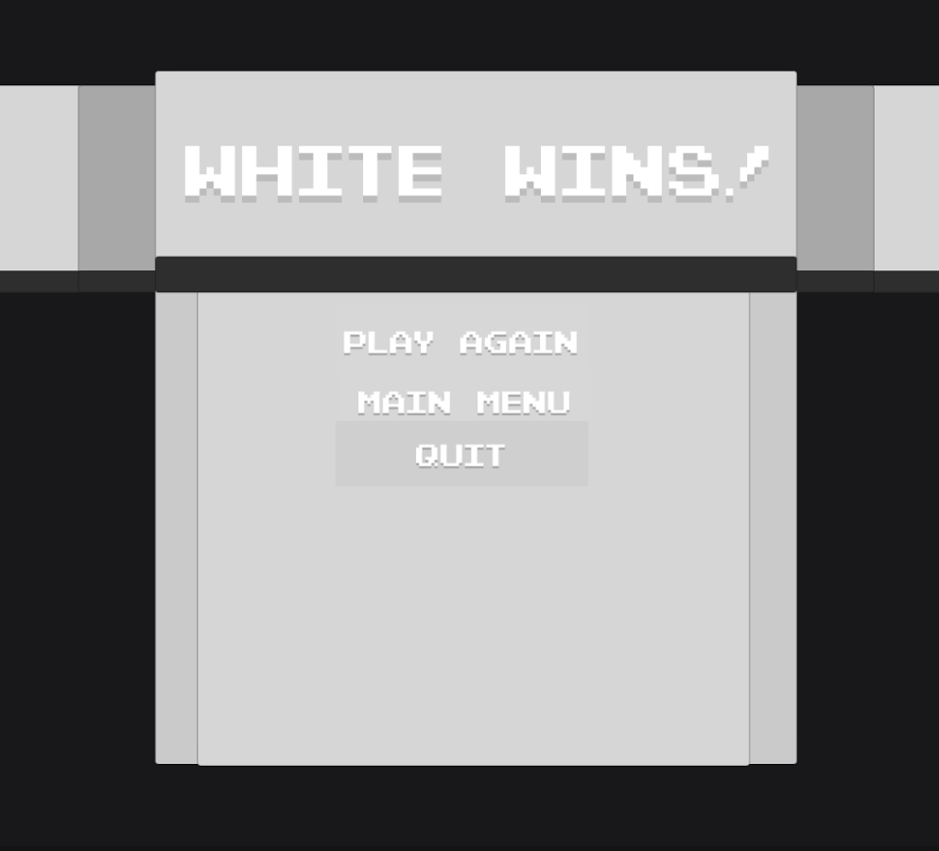
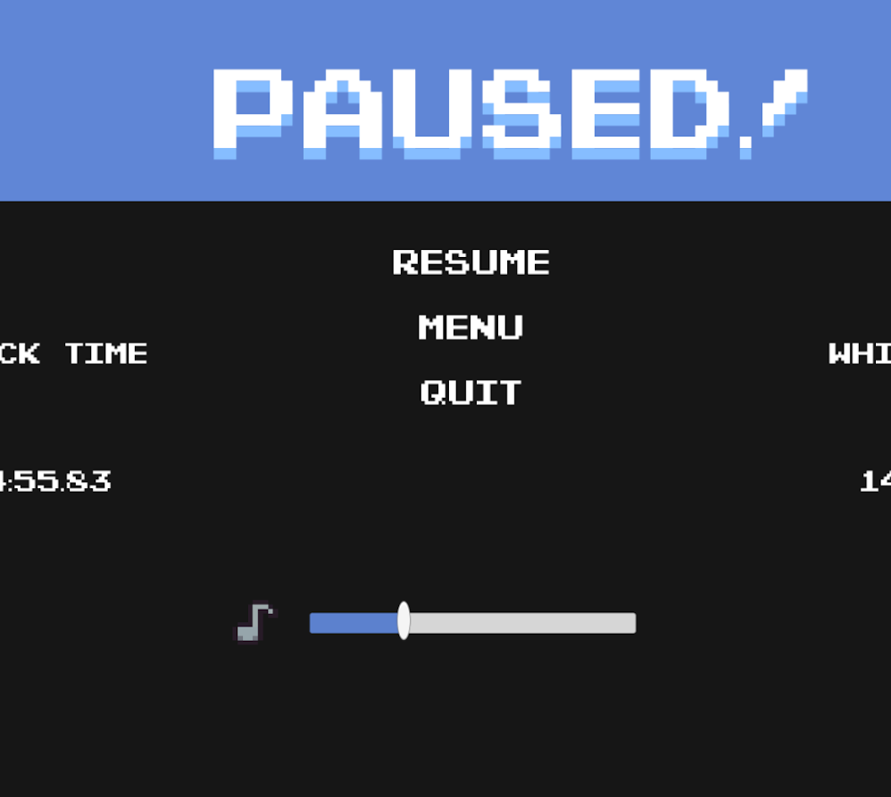
GUI and visual design
After settling on a design for the main menu, as the first screen the user will see we decided to stick with the retro pixel art aesthetic.
The visuals were designed with consistency in mind so that no graphic felt out of place.
A color pallet was also chosen, sticking to washed out color tones.

Slide 22
Sound design
To stay consistent with the visual side of the game the sounds, such as the music and sound effects of the GUI or the pieces were chosen specifically to fit the retro aesthetic.
All the sounds are 16bit, or derived from that era of games.

Slide 23
Future Plans
In the future our plans to continue the game would involve adding an AI opponent with varying levels of difficulty.
We would like to explore the possibilities of implementing multiplayer
Since chess as a game cannot receive new features and updates like other games due to its nature, we would focus our attention to bringing quality of life improvements and optimization.

Slide 24
Thank you for your attention!

